Slide 1
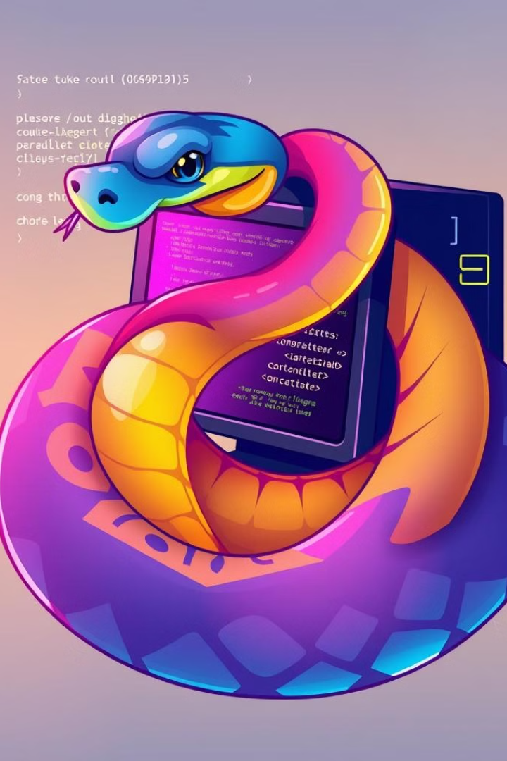
Python Fundamentals: A Comprehensive Guide
This presentation will cover the basics of Python programming, from setting up your environment to exploring essential concepts and techniques. We will delve into data types, control flow, functions, modules, and object-oriented programming, equipping you with the foundational knowledge necessary for effective Python development. Let's embark on this journey together!
by Munes Bani Fawaz

Slide 2
Python Data Types: The Building Blocks
Numbers
Strings
Lists
Other Types
Python supports various numeric types, including integers (int), floating-point numbers (float), and complex numbers (complex). These types are used for mathematical operations and represent numerical values.
Strings (str) represent textual data. They are enclosed in single or double quotes and can be manipulated using a variety of methods, such as concatenation, slicing, and formatting.
Lists (list) are ordered collections of items. They are mutable, meaning their elements can be changed. Items are accessed using their index, starting from 0.
Python offers other fundamental data types, including booleans (bool) representing truth values (True or False), sets (set) for unordered collections of unique elements, and dictionaries (dict) for storing key-value pairs.
colors = ["red", "green", "blue"]
print(colors[0]) # Output: "red"
name = "Python"
message = "Hello, " + name + "!"
print(message)
x = 10 # Integer
y = 3.14 # Float
z = 2 + 3j # Complex
is_active = True # Boolean
my_set = {1, 2, 3} # Set
user_info = {"name": "Alice", "age": 30} # Dictionary

Slide 3
Controlling the Flow: Conditional Statements and Loops
Conditional Statements
Loops
Conditional statements (if, elif, else) allow your code to execute different blocks of instructions based on specific conditions.
Loops (for, while) enable you to repeatedly execute a block of code until a specific condition is met. for loops iterate over sequences, while while loops continue as long as a condition is True.
age = 18
if age >= 18:
print("You are eligible to vote.")
else:
print("You are not eligible to vote yet.")
for i in range(5):
print(i) # Output: 0 1 2 3 4
count = 0
while count < 3:
print("Hello!")
count += 1

Slide 4
Functions: Modularizing Your Code
Defining Functions
Calling Functions
Functions are reusable blocks of code that perform specific tasks. They are defined using the def keyword, followed by the function name, parentheses for parameters, and a colon.
To execute a function, you call it by its name, followed by parentheses containing any required arguments. Functions can return values using the return keyword.
def add(x, y):
return x + y
result = add(5, 3)
print(result) # Output: 8
def greet(name):
print(f"Hello, {name}!")
greet("Alice") # Output: Hello, Alice!

Slide 5
Modules and Packages: Expanding Your Toolkit
Modules
Packages
Modules are Python files containing functions, classes, and variables that can be imported into other Python programs. They allow you to organize your code and reuse functionality.
Packages are collections of modules, organized hierarchically into directories. They provide a more structured way to manage and distribute related code.
import requests
response = requests.get("https://www.example.com")
import math
print(math.sqrt(25)) # Output: 5.0

Slide 6
File I/O: Interacting with Files
Reading Files
Writing Files
You can read data from files using the open() function in read mode ('r'). The read() method reads the entire file content, while readline() reads a single line.
To write data to a file, open it in write mode ('w'). The write() method inserts text into the file. Use 'a' for append mode to add data at the end of the file.
with open("data.txt", "r") as file:
content = file.read()
print(content)
with open("output.txt", "w") as file:
file.write("This is a new line.")

Slide 7
Object-Oriented Programming: Encapsulation and Abstraction
Classes
Objects
Classes are blueprints for creating objects. They define attributes (data) and methods (functions) that represent the characteristics and behaviors of objects.
Objects are instances of classes. They inherit the attributes and methods defined by the class. Each object maintains its own state, represented by its unique attribute values.
class Car:
def __init__(self, make, model, year):
self.make = make
self.model = model
self.year = year
self.speed = 0 # Initial speed
def accelerate(self):
self.speed += 5
print(f"The {self.make} {self.model} is now going {self.speed} mph.")
def brake(self):
self.speed -= 5
if self.speed < 0:
self.speed = 0
print(f"The {self.make} {self.model} is now going {self.speed} mph.")
def honk(self):
print("Beep! Beep!")
# Creating instances of Car
car1 = Car("Toyota", "Corolla", 2022)
car2 = Car("Honda", "Civic", 2021)
# Using the methods
car1.accelerate() # Output: The Toyota Corolla is now going 5 mph.
car2.honk() # Output: Beep! Beep!
# Printing car details
print(f"{car1.make} {car1.model} ({car1.year})") # Output: Toyota Corolla (2022)
print(f"{car2.make} {car2.model} ({car2.year})") # Output: Honda Civic (2021)

Slide 8
Handling Exceptions: Graceful Error Management
Try-Except Blocks
Raising Exceptions
Use the try-except block to handle potential errors during code execution. The code inside the try block is attempted, and if an exception occurs, the corresponding except block is executed.
You can raise exceptions explicitly using the raise keyword, allowing you to signal errors or handle specific situations in your code.
def check_age(age):
if age < 18:
raise ValueError("Age must be 18 or older.")
try:
check_age(15)
except ValueError as e:
print(f"Error: {e}")
try:
num1 = int(input("Enter a number: "))
num2 = int(input("Enter another number: "))
result = num1 / num2
print(f"The result is: {result}")
except ZeroDivisionError:
print("Error: Cannot divide by zero.")

Slide 9
Python Standard Library: Essential Tools
OS Module
Datetime Module
Random Module
The os module provides functions for interacting with the operating system, such as managing files, directories, and processes.
The datetime module enables you to work with dates and times. It provides classes for representing and manipulating these values.
The random module generates random numbers and sequences. It offers various functions for different types of randomization.
import os
print(os.getcwd()) # Get current working directory
os.mkdir("new_directory") # Create a directory
os.listdir(".") # List files and directories in the current directory
import datetime
now = datetime.datetime.now()
print(now) # Output: Current date and time
import random
random_number = random.randint(1, 10) # Random integer between 1 and 10
random_float = random.uniform(0, 1) # Random float between 0 and 1

Slide 10

Intermediate Python: Mastering Advanced Techniques

Slide 11

EDA Toolchain Automation: Streamlining Hardware Design
Electronic Design Automation (EDA) companies like Synopsys, Cadence, and Mentor Graphics provide essential tools for hardware application engineers. These tools encompass a wide range of functionalities emulation, simulation, static analysis, and prototyping. However, the design and verification process can be quite complex and time-consuming.

Slide 12





Automating the EDA Workflow
Automated Test Bench Creation
Batch Running Emulation Tests
Log Parsing and Error Analysis
Streamline the process of creating test benches for both simulation and emulation, reducing manual effort and ensuring consistent test coverage.
Efficiently execute a large number of emulation tests in parallel, reducing overall test time and enabling faster design verification.
Automate the process of parsing test logs and identifying potential errors, providing comprehensive insights into design behavior.
Regression Testing Framework
FPGA Prototyping Workflow Automation
Establish a robust framework for regression testing, ensuring that design changes don't introduce unexpected issues or regressions.
Streamline the entire FPGA prototyping workflow, from design synthesis to bitstream generation and board configuration, reducing manual steps and increasing efficiency.

Slide 13
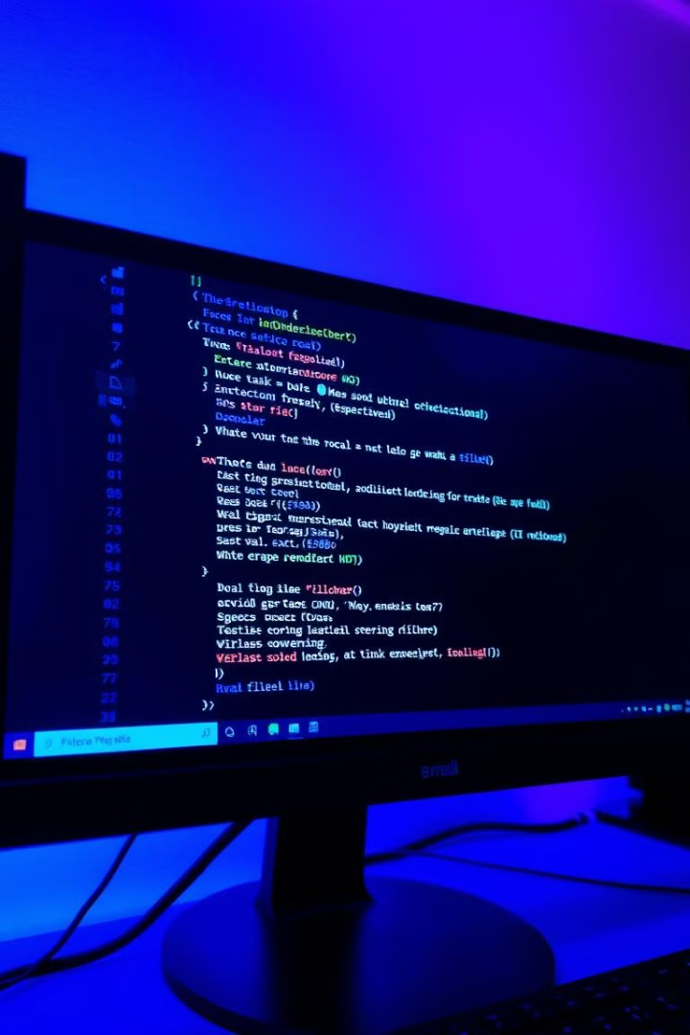
Log Parsing and Error Analysis in EDA Workflows
Here we will explores the crucial role of automated log parsing and error analysis in modern data analysis workflows, empowering you to gain valuable insights and optimize your applications.

Slide 14
Importance of Automated Log Parsing
Proactive Issue Detection
Enhanced Debugging
Improved Application Performance
Automated parsing allows for the early detection of potential issues, preventing them from escalating into major problems.
Detailed error analysis provides invaluable information for pinpointing the root cause of issues and streamlining the debugging process.
Identifying and addressing performance bottlenecks based on log data leads to optimized application efficiency.

Slide 15
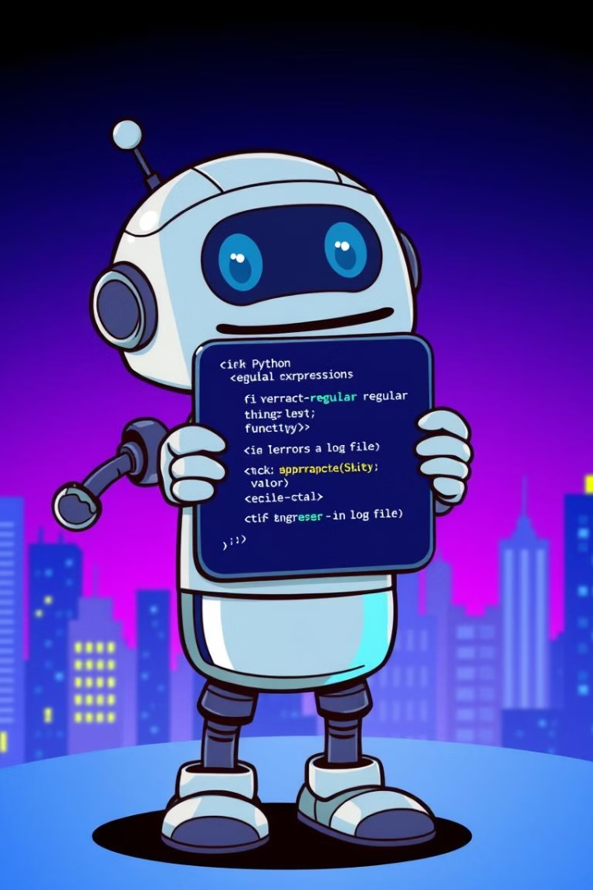
Step 1: Error Extraction with Regular Expressions
import re def extract_errors(log_file): errors = [] with open(log_file, 'r') as file: for line in file: match = re.search(r"ERROR: (.*)", line) if match: errors.append(match.group(1)) return errors errors = extract_errors("my_log_file.txt") print(errors)

Slide 16
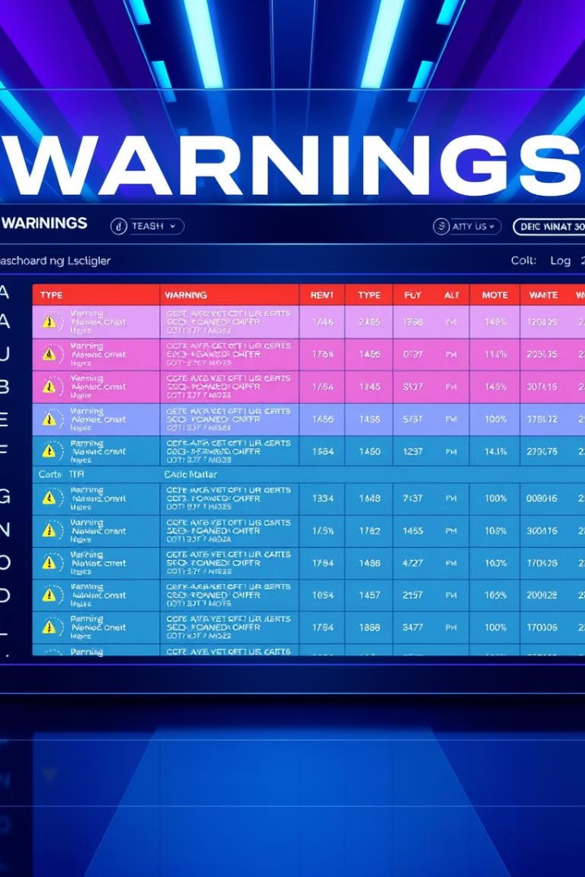
Step 2: Warning Analysis and Categorization
Warning Categorization
Frequency Analysis
Identify frequently occurring warnings and investigate potential underlying issues.
Classify warnings by type (e.g., database connection, API call, file access) and severity (e.g., informational, critical).
Contextual Analysis
Analyze warning messages in the context of surrounding log entries to gain a deeper understanding.

Slide 17
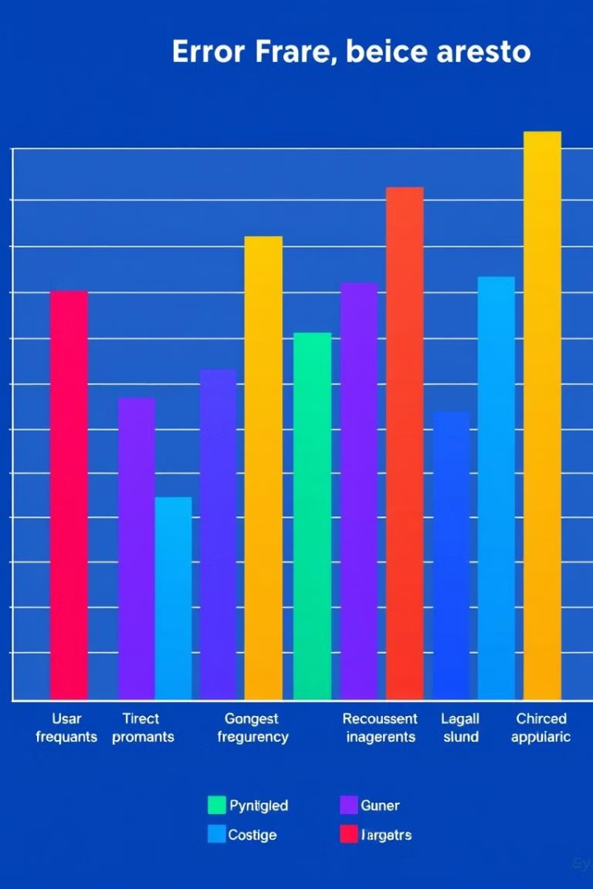
Step 3: Metrics Summary and Reporting
100
20%
Error Count
Warning Rate
Total number of errors identified in the log file.
Percentage of log entries containing warnings.
5
Critical Errors
Number of critical errors requiring immediate attention.

Slide 18

Leveraging Pandas for Data Manipulation
import pandas as pd log_data = pd.read_csv("my_log_file.csv") error_counts = log_data["Error"].value_counts() print(error_counts)

Slide 19

Visualizing Trends with Matplotlib and Seaborn
import matplotlib.pyplot as plt import seaborn as sns sns.lineplot(x="Timestamp", y="Error Count", data=log_data) plt.show()

Slide 20
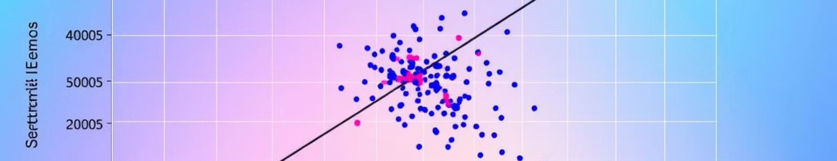
Identifying Patterns and Outliers
sns.scatterplot(x="Error Type 1", y="Error Type 2", data=log_data) plt.show()

Slide 21

Triggering Notifications for Critical Errors
import smtplib from email.mime.text import MIMEText def send_notification(error_message): # Send an email notification about the error msg = MIMEText(error_message) msg['Subject'] = 'Critical Error Alert' msg['From'] = 'your_email@example.com' msg['To'] = 'recipient_email@example.com' with smtplib.SMTP('smtp.example.com', 587) as server: server.starttls() server.login('your_email@example.com', 'your_password') server.sendmail('your_email@example.com', 'recipient_email@example.com', msg.as_string())

Slide 22





Integrating Log Parsing into Continuous Integration
1
Code Build
2
Code Testing
3
Log Parsing
4
Error Analysis
5
Actionable Insights

Slide 23
Task 1
Objective
Parse a simulated log file to extract:
Errors (lines containing "ERROR").
Warnings (lines containing "WARNING").
A count of errors and warnings.
Save the results into a summary file.
Steps:
Create a Sample Log File:
Generate a .log file with entries simulating errors, warnings, and other information.
Write a Python Script:
Open the log file and read its contents.
Use string matching or regular expressions to find lines with errors and warnings.
Count the number of occurrences of each.
Save the results in a text summary file.
Run the Script:
Test the script with the sample log file and verify the output.

Slide 24
Task 2
Objective
Create a Python script to:
Parse a log file for metrics (e.g., errors, warnings, and information entries).
Display the metrics in an interactive web dashboard with visualizations.
Steps:
Install Required Libraries: Use streamlit for the dashboard and pandas for data handling (pip install streamlit pandas)
Create a Sample Log File: Use the same sample.log as in the previous example.
Write a Python Script:
Parse the log file to extract metrics.
Visualize metrics using tables and charts.
Save the code to a Python file, e.g., log_dashboard.py.
Run the Script:
streamlit run log_dashboard.py
Open the dashboard in your browser (URL will appear in the terminal).

